Slide 1
CSE 4128 Image Processing and Computer Vision Laboratory Week 2: Segmentation(Edge Detection)
Dr. Sk. Md. Masudul Ahsan
Professor
Dept. of CSE, KUET
Dipannita Biswas
Lecturer
Dept. of CSE, KUET

Slide 2
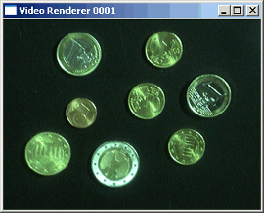

Segmentation
Segmentation subdivides an image into its constituent regions or objects.
Separating objects from the background and giving them individual labels(ID numbers)
Segmentation attempts to partition the pixels of an image into groups that strongly correlate with the objects in an image

Slide 3
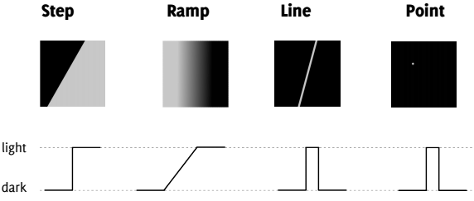
Edge Detection
It is most frequently used for segmenting images based on abrupt(local) changes in intensity. It centers around contour detection.
An edge is a set of connected pixels that lie on the boundary between two regions
Edge models

Slide 4
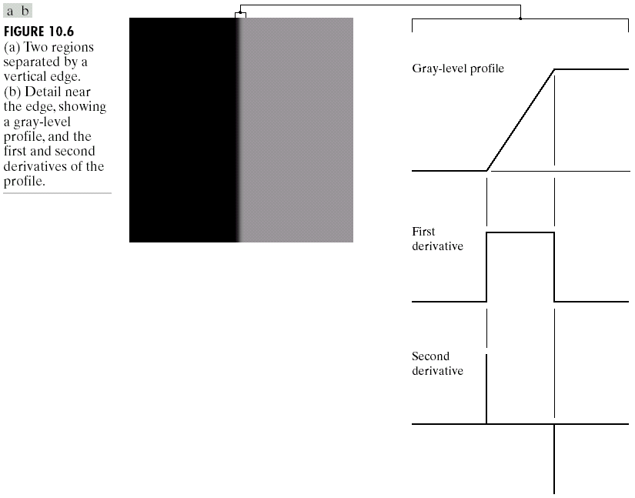
Edge and Derivatives
Derivatives are used
to find discontinuities.
1st derivative tells us
where an edge is.
2nd derivative can be used to show edge side

Slide 5
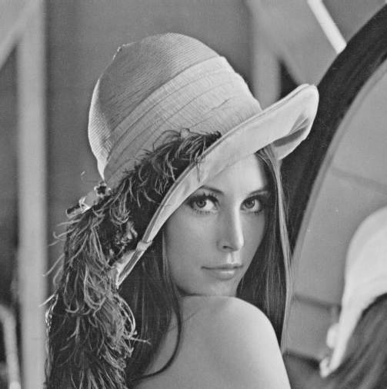
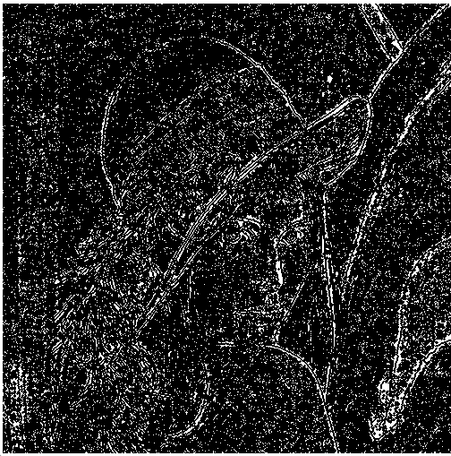
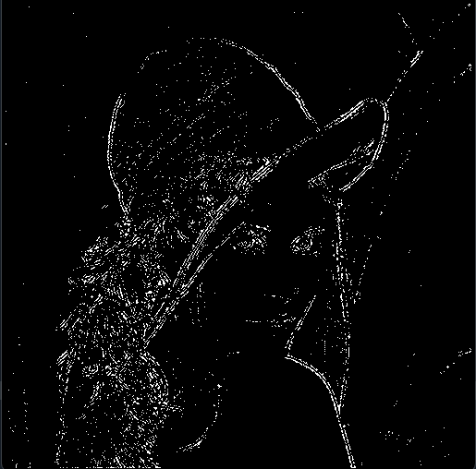

Segmentation with Edge Detection
Input
Applying Zero-crossing
Applying thresholding
(local sigma >60)
Convolving with LoG kernel with Sigma = 1, kernel size= 7X7

Slide 6
Robust Laplacian-based Edge Detector
estimate
local variance
σ²
LoG
operator
zero
crossing?
yes
edge
point
image
σ²>th
No
No
not an
edge point
not an
edge point

Slide 7
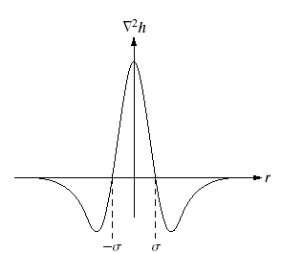
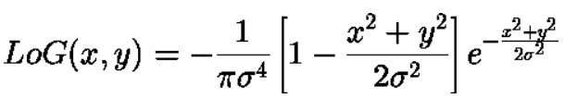
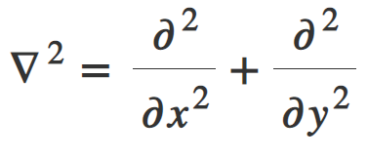
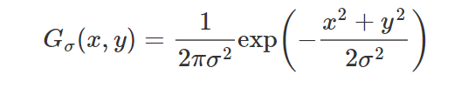
Laplacian Of Gaussian
The Laplacian of Gaussian (or Mexican hat) filter uses the Gaussian for noise removal and the Laplacian for edge detection
this can also be performed by smoothing with a Gaussian kernel and then taking its Laplace, we can obtain the Laplacian of the Gaussian kernel.
Laplacian:
Gaussian:

Slide 8
Zero crossing and Thresholding
= 2.5 ,
Threshold = 2
1 | 1 | 1 | -1 | 1
3 | 3 | -3 | 3 | 4
3 | 4 | 4 | 3 | 1
1 | -1 | 1 | 1 | 2
1 | 2 | -2 | 1 | 2
0 | 0 | 0 | 0 | 0
0 | 3 | -3 | 3 | 0
0 | 4 | 4 | 0 | 0
0 | -1 | 1 | 0 | 0
0 | 0 | 0 | 0 | 0
0 | 0 | 0 | 0 | 0
0 | 255 | 255 | 255 | 0
0 | 0 | 255 | 0 | 0
0 | 0 | 255 | 0 | 0
0 | 0 | 0 | 0 | 0
zero
crossing
σ²>
threshold

Slide 9
Laplacian Edge Detection
Unlike first-order filters that detect the edges based on local maxima or minima, Laplacian detects the edges at zero crossings i.e. where the value changes from negative to positive and vice-versa.
zero crossing
f
f’
f’’
image
Laplacian
operator
edge
map
zero-crossing
f(x,y)
g(x,y)
E(x,y)

Slide 10
Assignment
Create a region-based segmentation method applying the splitting technique.
Instructions:
Use RGB image.
Show the change in the merged image with the variation of the threshold, which will be user-input.

Slide 11
Algorithm
It starts with the assumption that the entire image is homogeneous.
Homogeneity can be considered as the standard deviation of the sub-image < threshold.
Check if the image is homogenous:
If this is not true, the image is split into four sub-images.
This splitting procedure is repeated recursively until we split the image into homogeneous regions.
Return the concatenated split sub-images.

Slide 12
Quadtree
If the original image is square N x N, all regions produced but the splitting algorithm are squares having dimensions M x M.
Since the procedure is recursive, it produces an image representation that can be described by a tree whose nodes have four sons each. Such a tree is called a Quadtree.
R0
R1
R0
R1
R2
R3
R3
R2
R00
R01
R02
R04

Slide 13
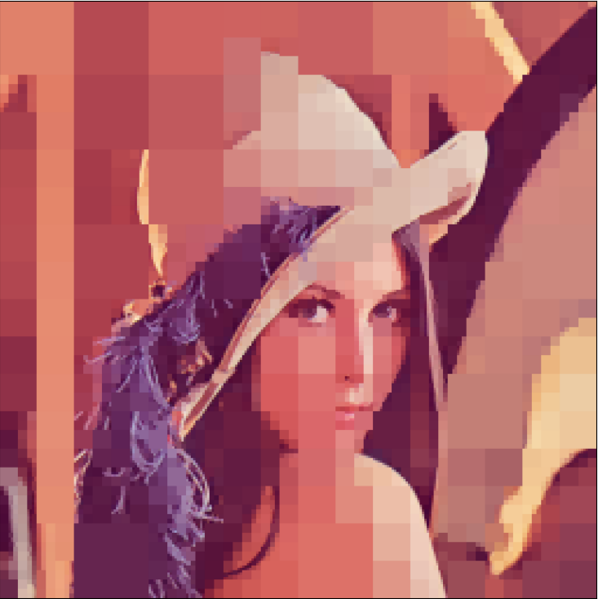
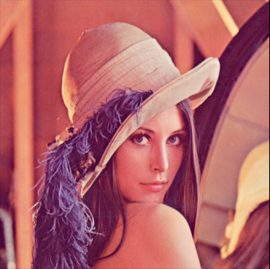

Output Results
Input image
Split into 2X2 and merge
Output image, with threshold 25

